Slide 1
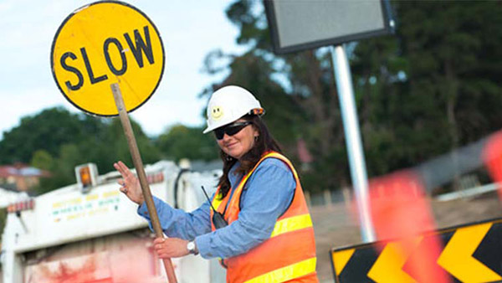
Event Traffic Controller Course

Slide 2
Administration Information
Transport Canberra and City Services Directorate
Capital Cycling
Blended Learning International - Registered Training Organisation (RTO)

Slide 3
Administration Information
Require you to read:
http://www.blendedlearning.edu.au/home/policies-forms/
Must obtain today a Unique Student Identifier
www.usi.gov.au

Slide 4
Units of Competency
RIICOM201D Communicate in the Workplace.
RIIWHS201D Work Safely and Follow WHS Policies and Procedures.
RIIWHS205D Control Traffic with Stop-Slow Bat.

Slide 5
Communicate In The Workplace

Slide 6
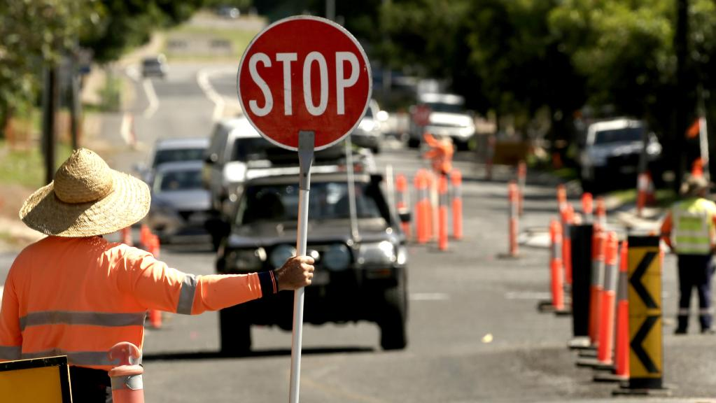
Introduction
Communication equipment and systems.
Face-to-face communication.
Written communication (documentation).
Notes:
This course is based on the unit of competency RIICOM201D Communicate in the Workplace.
In this training course you will learn about:
Communication equipment and systems.
Face-to-face communication.
Written communication (documentation).

Slide 7
Workplace Communication
Good communication is one of the most important things to help make sure any workplace is running properly.
It is important that all communications that happen at work are:
Clear.
Concise.
Easily understood.
Meets the requirements of event rules, policies and procedures.
Notes:
Good communication is one of the most important things to help make sure any workplace is running properly.
This includes all written and spoken communication.
Everything you read, write and talk about with other personnel is contributing to effective communication.
It is important that all communications that happen at work are clear, to the point, easily understood and meet the requirements of site rules, policies and procedures.

Slide 8
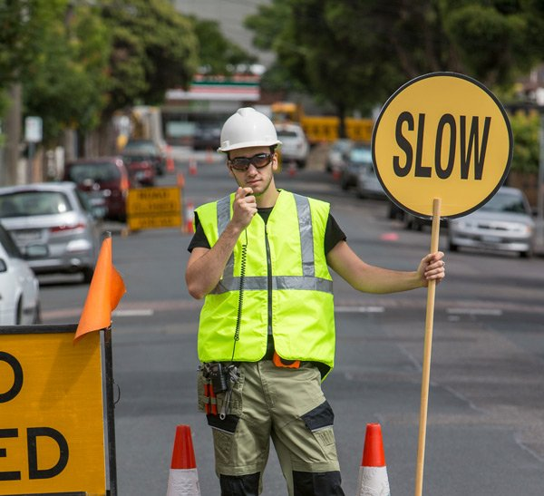
Working Safely
Follow all safety rules and instructions when performing any work.
If you are unsure, ask your supervisor.
Notes:
8
You must follow all safety rules and instructions when performing any work. If you are not sure about what you should do, ask your boss or supervisor. They will tell you what you need to do and how to do it in a safe way.

Slide 9
Health & Safety Rules
The 4 main types:
Acts | Laws that you have to follow
Regulations | Explain what the law means
Codes of Practice | Instructions on how to follow the law
Australian Standards | Tell you what the minimum requirement is for a job, product or hazard.
Notes:
9
Every workplace has to follow laws and rules to keep everyone safe. There are 4 main types:
Acts – These are laws that you have to follow.
Regulations – These explain what the law means.
Codes of Practice – These are instructions on how to follow the law, based on industry standards.
Australian Standards – These tell you what the minimum requirement is for a job, product or hazard.
Some states use OHS laws, and other states use WHS laws. They both talk about the same thing, but use different words or names for people. If you have any questions about safety rules you should talk to your boss or supervisor.

Slide 10
Operations Documentation
Temporary Traffic Management Plan (TTMP)–ACT
Traffic Control Plan (TCP) – NSW Traffic Guidance Scheme (TGS) referred to nationally in the near future
WHS plans
Communication plan
Emergency procedures
Fault procedures
Hazard details
Following these Operations Documents allows you to meet the minimum WHS and Legislative requirements associated with the delivery of an event
Notes:
10
Operations documentation includes:
Document Type & Examples
Site Details – The information and safety requirements of the workplace environment (where you will be working).
Hazard Details – Any hazards in the work area or related to the work. This could also include instructions on how to handle dangerous or hazardous materials.
Task Details – Instructions of what the work is or what you will be doing. Also instructions on how to safely do the job.
Faulty Equipment Procedures – Isolation procedures to follow or forms to fill out.
Signage – Site signage tells you what equipment you need to have, or areas that are not safe to be in.
Emergency Procedures – Instructions on what to do in emergency situations, for example if there is fire, accident or emergency where evacuation or first aid is needed.
Equipment and Work Instructions – Details of how to operate plant and equipment and the sequence of work to be done.
Communications Instructions/ Requirements – Details of communications that need to be maintained during work activities such as:
Reporting (spoken and written) progress, issues, incidents, faults and other relevant information.
Giving, receiving and confirming instructions.
Filling out forms.
Warning other workers about hazards or dangers.
Signing off on permits or work instructions.

Slide 11
Emergency Procedures
Emergency communication procedures:
Written emergency procedures and policies.
Reporting of incidents or emergencies.
Maintaining communication and keeping people up-to-date.
Communicating with emergency services.
Writing of reports and records.
If you are not sure where these documents can
Be accessed contact the Event Coordinator or
Race Director
Notes:
11
Each workplace will have communications safety procedures to be followed in the case of an emergency.
Emergency communication procedures may include:
Written emergency procedures and policies.
The reporting of incidents or emergencies to relevant personnel.
Warning procedures including sirens and announcements.
Maintaining communication and keeping people up-to-date.
Communicating with emergency services (e.g. fire service).
Communicating with other relevant agencies (e.g. electrical power service).
Writing of reports and records.

Slide 12
Choose the Right Way to Communicate
Communication methods may include:
Talking via radios or telephone.
Signalling using lights, flags and signs.
Electronic communication.
Written communication.
Face-to-face conversations and discussions.
Notes:
12
The way you communicate with others will depend on the requirements of the job or task, standard procedure and the availability of communication equipment.
Communication methods may include:
Talking via radios or telephone.
Signalling using sound with bells, whistles and sirens.
Signalling using lights, flags and signs.
Electronic communication via a computer, tablet and smartphone (e.g. sending and receiving emails, SMS or video calls).
Written communication (e.g. documents, reports, forms, notes, letters, memos and other paperwork).
Face-to-face conversations and discussions (verbal communication).
Using the right communication method helps to make sure that the information is passed on quickly and accurately.

Slide 13
Choose the Right Way to Communicate
To establish and maintain effective communication with other personnel make sure you:
Use communication equipment properly.
Fill out forms or reports properly.
Speak clearly and use plain English.
Check that the person you are communicating with understands what you are saying and has received the message in full. This can be done by paraphrasing and asking questions to seek clarification
Notes:
13
To establish and maintain effective communication with other personnel make sure you:
Use communication equipment properly.
Fill out forms or reports properly, in handwriting that is easy to read, or use a computer to fill them in electronically.
Speak clearly and use plain English.
Check that the person you are communicating with understands what you are saying and has received the message in full. You can ask them questions or let them ask you questions to confirm that they understand what you are trying to communicate. You can also get them to explain it back to you in their own words.

Slide 14
Communication Breakdown
Sometimes it can be difficult to get your message across because of:
Misunderstanding – unfamiliar or technical language.
Misunderstanding – misinformation or inaccurate information
Low language or literacy skills.
Notes:
14
There may be times when communications are not clear. This can be caused by a number of reasons. Sometimes it can be difficult to get your message across because of:
Misunderstanding caused by unfamiliar or technical language.
Misunderstanding caused by misinformation or inaccurate information.
Low language or literacy skills.
Continued…

Slide 15
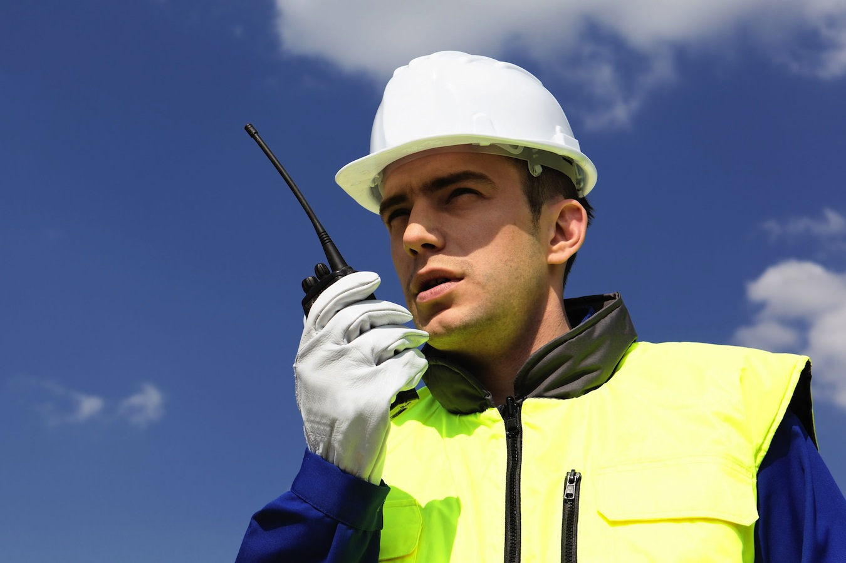
Communication Breakdown
Background noise.
Damaged or faulty communication equipment.
The way you are trying to communicate.
Try to avoid these things to keep communications in the workplace clear.
Notes:
15
Background noise that makes it hard to hear what people are saying, especially when talking on the phone or over two-way radio.
Damaged or faulty communication equipment.
The way you are trying to communicate. If you are not using the right or expected methods of communication it can cause confusion. An example of this is verbally passing on a message when you are supposed to complete and hand in a form or report instead.
Try to avoid these things to keep communications in the workplace clear.

Slide 16
Communication Equipment

Slide 17
Communication Systems and Equipment
It is important that you identify the systems and equipment being used at your workplace so that you can make sure you are communicating with others in the right, and expected way.
Notes:
17
There is a range of communication systems and equipment that is used in various workplaces.
It is important that you identify the systems and equipment being used at your workplace so that you can make sure you are communicating with others in the right, and expected way.

Slide 18
Communication Systems
Have a range of parts including:
The systems overview.
Operating directories.
Communication equipment.
Event specific procedures.
Emergency procedures.
Notes:
18
Communication systems can be made up of a range of parts including:
The Systems Overview – what equipment is available and how communications need to be maintained during different types of work.
Operating Directories – details of all personnel and communications in use across a work site.
Communication Equipment – phones, radios, computers, pagers, lights, bells, buzzers, whistles or any other equipment that is used to communicate with other workers across a range of activities.
Site Specific Procedures including:
Call signs – names used to identify different people, equipment and parts of a project or site.
Area descriptions.
Voice procedure – the way you need to speak when using equipment to make sure others can understand you and know when you have finished speaking.
Protocols – rules or standard practices relating to communication equipment and systems.
Emergency Procedures – emergencies may need to be handled and communicated in a particular way to make sure people avoid danger and get help or assistance as soon as possible.

Slide 19
Communication Equipment
Radio.
Telephone.
Computer.
Audible signs.
Physical signs.
Hand signals.
Written documentation.
Notes:
19
Communication equipment used in a workplace may include:
Radio (e.g. fixed frequency two-way radio).
Telephone.
Computer.
Audible signals such as bells, whistles and sirens.
Physical signals such as lamps, lights and flags.
Hand signals.
Written documentation (pens, forms, documents, reports).

Slide 20
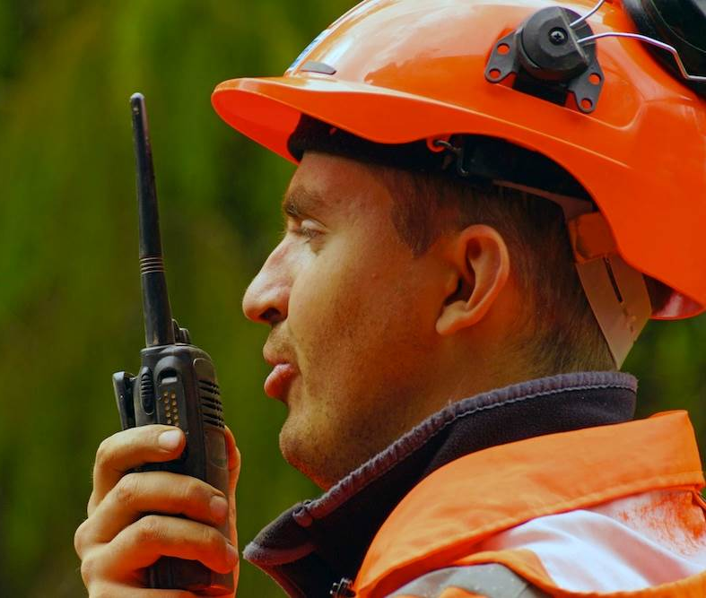
Communication Equipment
Two-way radios are useful, but you should use fixed channel.
Audible signals are useful for giving directions where you do not have constant line of sight with the person you are communicating with.
Using visual signals is only appropriate where the person you are communicating with can see you at all times.
Notes:
20
Two-way radios are useful, especially on big work sites, but you should use fixed channel or trunked radios if you are communicating with just one person during a job. This will stop any interference on the channel and make sure you don’t pass messages, directions or instructions to the wrong person.
Audible signals are useful for giving directions where you do not have constant line of sight with the person you are communicating with.
Using visual signals like lights, flags or hand signals to direct, or receive directions from another worker is only appropriate where the person you are communicating with can see you at all times, but may not necessarily be able to hear you because of background noise or the distance between you.

Slide 21
Equipment Safety Procedures
Safety procedures for communication equipment and systems include:
Equipment maintenance.
Equipment use.
Guidelines and instructions around communication equipment that is not allowed to be used.
Fault reports.
Hazard reports and risk assessments.
Notes:
21
Safety procedures that relate to communication systems and equipment focus on the correct use of equipment and systems in each situation. This focus aims to avoid incidents caused by poor communication, misunderstandings or using the equipment incorrectly.
Safety procedures for communication equipment and systems includes:
Equipment maintenance – guidelines on keeping communication equipment operating properly.
Equipment use – rules around how, when and where you can use equipment.
Guidelines or instructions around communication equipment that is not allowed to be used. In some cases you may not be allowed to use mobile phones on work sites or in certain areas.
Fault reports – to warn other personnel of dangerous or faulty equipment.
Hazard reports and risk assessments – identified unsafe situations need to be documented and managed in the right way to keep everybody safe.
Check with your supervisor or other authorised and experienced personnel to see if there are any safety requirements for any communication equipment you need to use.

Slide 22
Use Communication Equipment and Systems
Before you use any communication equipment make sure:
You are using the right method for the situation.
The equipment is in good condition and works properly.
You know how to operate it properly.
Notes:
22
Before you use any communication equipment make sure:
You are using the right method of communication for the situation.
The equipment is in good condition and works properly.
You know how to operate it properly.

Slide 23
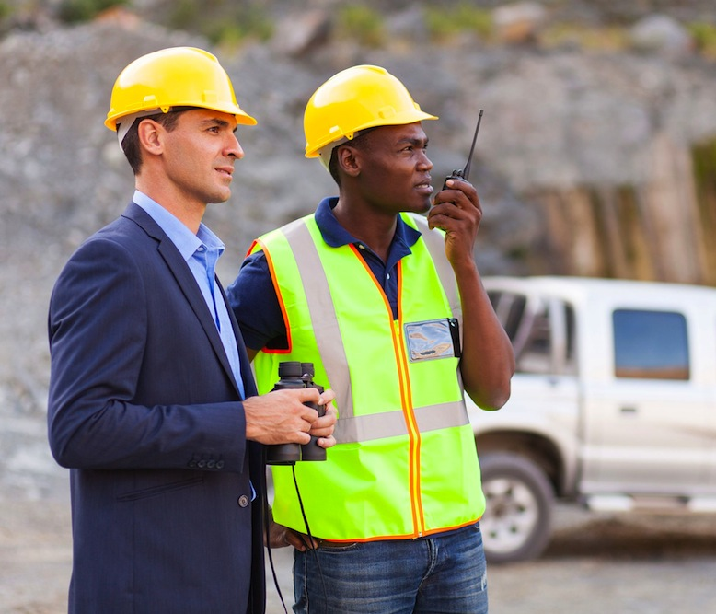
Use Communication Equipment and Systems
Operate all equipment in line with workplace rules, policies, procedures and instructions.
Communicate clearly and give direct and prompt directions or responses to other personnel while you work.
Notes:
23
Operate all equipment in line with workplace rules, policies, procedures and instructions. For example, you may need to use specific call signs and voice procedures, or include specific details in written documents and emails.
Communicate clearly and give direct and prompt directions or responses to other personnel while you work. This will keep everything running smoothly and make sure everybody understands what is going on.
If an unexpected situation occurs that is caused by the way you are operating the communication equipment you should stop and assess the situation. Talk to other personnel and work out how you will communicate and what equipment you will use for the remainder of the work.

Slide 24
Receive Communications from Others
Confirm all communications you receive (written and verbal) with the person you receive it from.
This will make sure you understand what the other person is trying to tell you.
Notes:
24
Communication is a two-way process. Listening is sometimes more important than talking.
Throughout your work day you will receive a range of communications from other personnel, especially when you are working on a large site, or in a work team, crew or group.
Confirm all communications you receive (written and verbal) with the person you receive it from. This will make sure you understand what the other person is trying to tell you. This is especially important when you are receiving instructions from your supervisor or other personnel.

Slide 25
Use Communication Equipment and Systems
All communication must be clear, concise and timely
This avoids confusion and frustration which could lead to
poor WHS practices
If you do not understand an instruction or a communication you must seek clarification as a priority - usually through well structured questions
Notes:
25
Other workers you are communicating with know what you are doing and what equipment you are using.
Other workers will be able to understand what you are telling them with the communication equipment.
The equipment will not cause any hazards, incidents or unsafe situations for yourself and other personnel in the area.

Slide 26
Receive Communications from Others
If you are receiving signals from another worker, make sure you follow them exactly. If something does not seem right in the directions you are receiving you should stop and confirm that you are both looking at the situation the same way.
Notes:
26
If you are receiving signals from another worker, such as hand signals, whistle signals or other appropriate directions, make sure you follow them exactly. If something doesn’t seem right in the directions you are receiving you should stop and confirm that you are both looking at the situation the same way.

Slide 27
Receive Communications from Others
Acknowledge all communications that you receive.
Do not assume that the person communicating with you knows that their message has been received and understood without you acknowledging it.
It is important to acknowledge and respond to all communications so that other personnel know that you have received the message.
If an unexpected issue arises from you operating the communication equipment quickly use your mobile phone
Notes:
27
Acknowledge all communications that you receive. Do not assume that the person communicating with you knows that their message has been received and understood without you acknowledging it.
It is important to acknowledge and respond to all communications so that other personnel know that you have received the message.

Slide 28
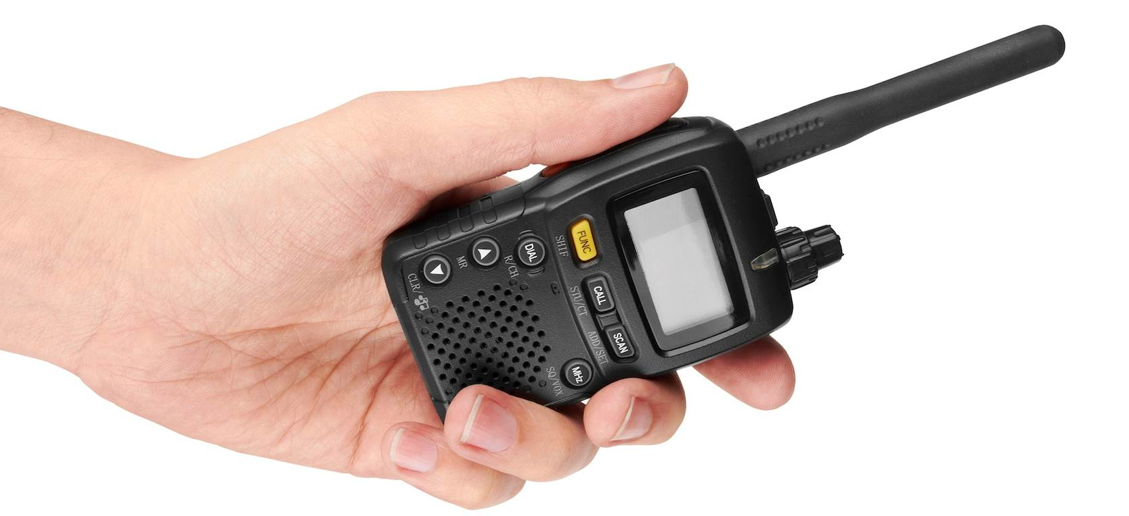
Identify and Report Faults in Equipment
Before you use any communication equipment make sure it has been checked and tested. If you are unfamiliar with the equipment get somebody who knows how to use it to show you how to check it.
Notes:
28
Before you use any communication equipment make sure it has been checked and tested. If you are unfamiliar with the equipment get somebody who knows how to use it to show you how to check it.

Slide 29
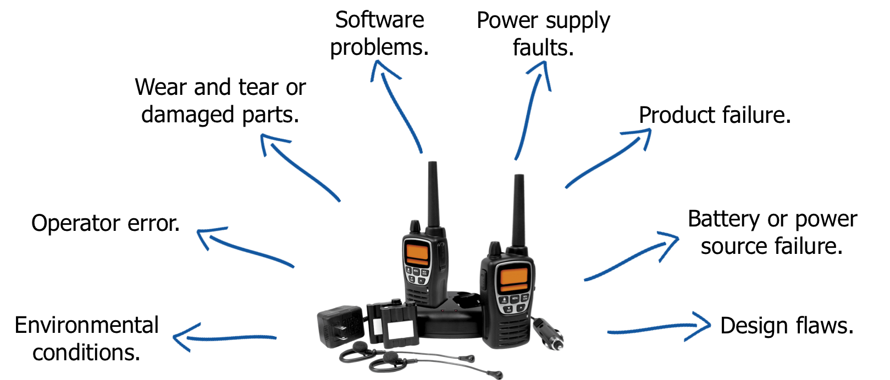
Common Faults in Equipment and Systems
Common things that will affect the operation of communication equipment and systems can include:
Never use faulty or defective equipment. If it fails during operations you could put yourself or others at risk.
Notes:
29

Slide 30
Report and Record Faults
A typical procedure for the reporting and recording of faults may include:
Tagging the item.
Recording the problem.
Reporting the fault.
Notes:
30
Once a fault has been identified with communication equipment it is your responsibility to report it and record the fault according to site procedures.
A typical procedure for the reporting and recording of faults may include:
Tagging the item of communication equipment to stop anybody from using it.
Recording the problem in a logbook or on an inspection checklist. Make sure that you give as much detail as possible.
Reporting the fault to your supervisor or other authorised person.

Slide 31
Report and Record Faults
Tagging an item involves placing a tag on the piece of equipment so that others are award that it should not be used (‘isolation’).
This tag will need to stay in place until the fault has been fixed and the equipment has been certified as fit for use.
Never use an item out of communication that has been tagged out.
Never remove the tags from the equipment.
Notes:
31
Tagging an item involves placing a tag on the piece of equipment so that others are aware that it should not be used. This is also known as ‘isolation’.
This tag will need to stay in place until the fault has been fixed and the equipment has been certified as fit for use. Never use an item of communication that has been tagged out and never remove the tags from the equipment.

Slide 32
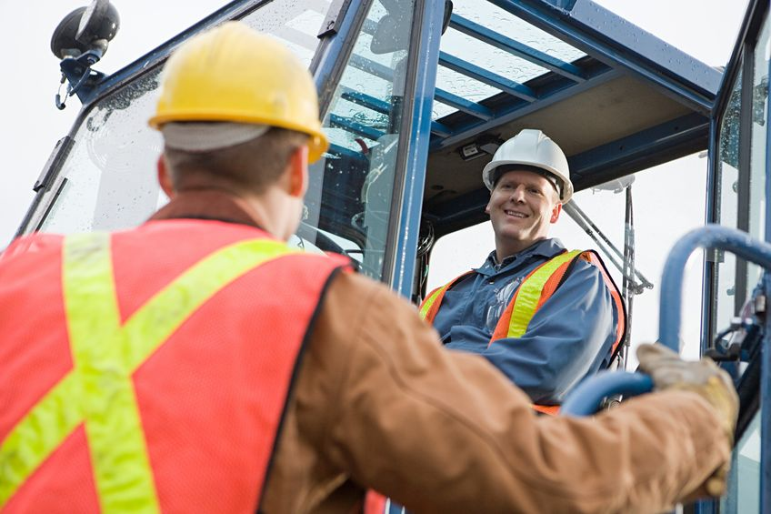
Workplace Communications

Slide 33
Speak Clearly and Listen Carefully
It is important that you speak clearly and listen carefully to make sure:
Everyone understands what has been said.
Everybody knows what they are to do.
Be respectful. Avoid slang terms and ‘in-jokes’ as they may confuse or offend others. Try to avoid overly technical terms and ideas.
Notes:
33
It is important that you speak clearly and listen carefully to make sure:
Everyone understands what has been said.
Everybody knows what they are supposed to do.
When talking with other people in the workplace face-to-face make sure you are respectful. Avoid slang terms and ‘in-jokes’ as they may confuse or offend others. Try to avoid overly technical terms and ideas when dealing with workers that may not be familiar with them.

Slide 34
Speak Clearly and Listen Carefully
Listen carefully and clarify any points of the conversation that you are not sure about.
Try to leave the conversation with everybody clear about what has been said and aware of what they need to do with this information.
Notes:
34
Listen carefully and clarify any points of the conversation that you are not sure about. Make sure that the other person or people you are talking to understand what you have said.
Try to leave the conversation with everybody clear about what has been said and aware of what they need to do with this information.

Slide 35
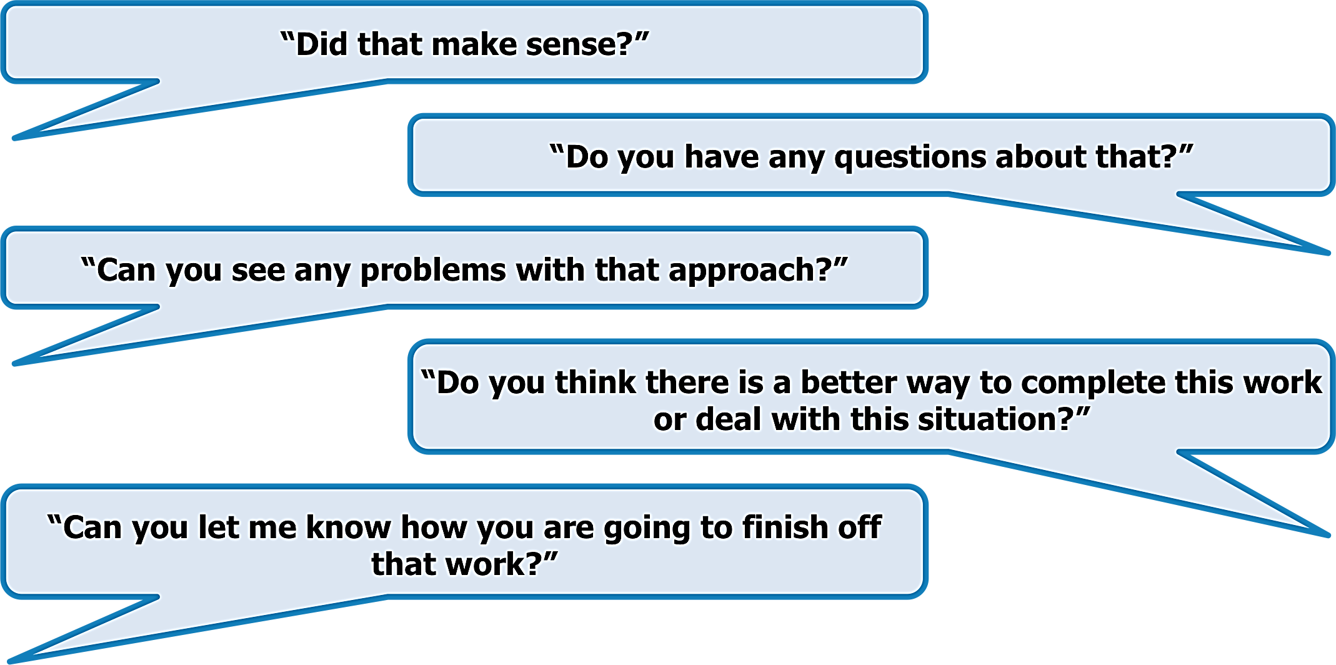
Ask Questions and Confirm Information
Make sure you take the opportunity to ask questions to confirm any details that you are unclear about.
You can ask:
Notes:
35
Make sure you take the opportunity to ask questions to confirm any details that you are unclear about. You can also ask other people questions to confirm that they have understood what you have said.
You can ask:
“Did that make sense?”
“Do you have any questions about that?”
“Can you see any problems with that approach?”
“Do you think there is a better way to complete this work or deal with this situation?”
“Can you let me know how you are going to finish off that work?”

Slide 36
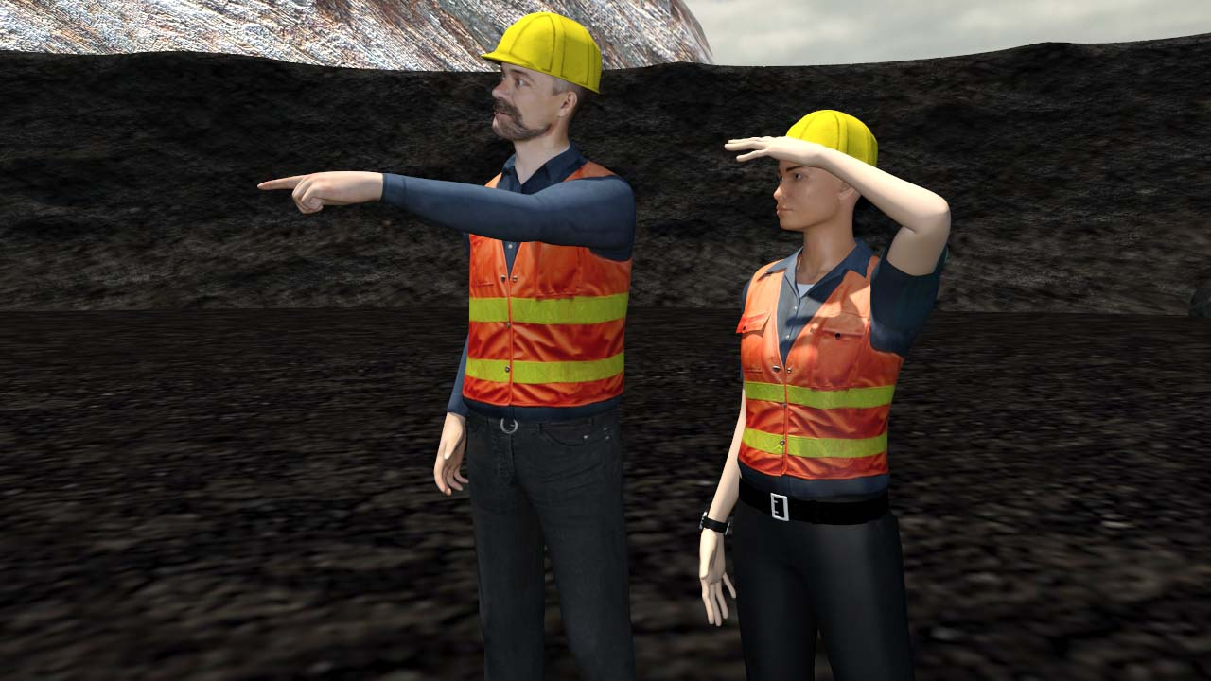
Ask Questions and Confirm Information
Always take the time to confirm any details that you are not 100% sure about and to confirm that other people have understood what you have said.
Notes:
36
Always take the time to confirm any details that you are not 100% sure about and to confirm that other people have understood what you have said or what you are asking of them.
Miscommunication can lead to serious accidents and disruptions in the workplace.

Slide 37
Use Communication Signals
Signalling methods used in a workplace:
Hand signals.
Safety lights.
Make sure you use only sight approved signalling methods to convey information.
Notes:
37
Signalling methods used in a workplace may include:
Hand signals.
Horn and/or whistle.
Safety lights.
Cap lamp.
Make sure you use only site approved signalling methods to convey information. The meaning of all signals used should be understood by whoever is giving and receiving them.

Slide 38
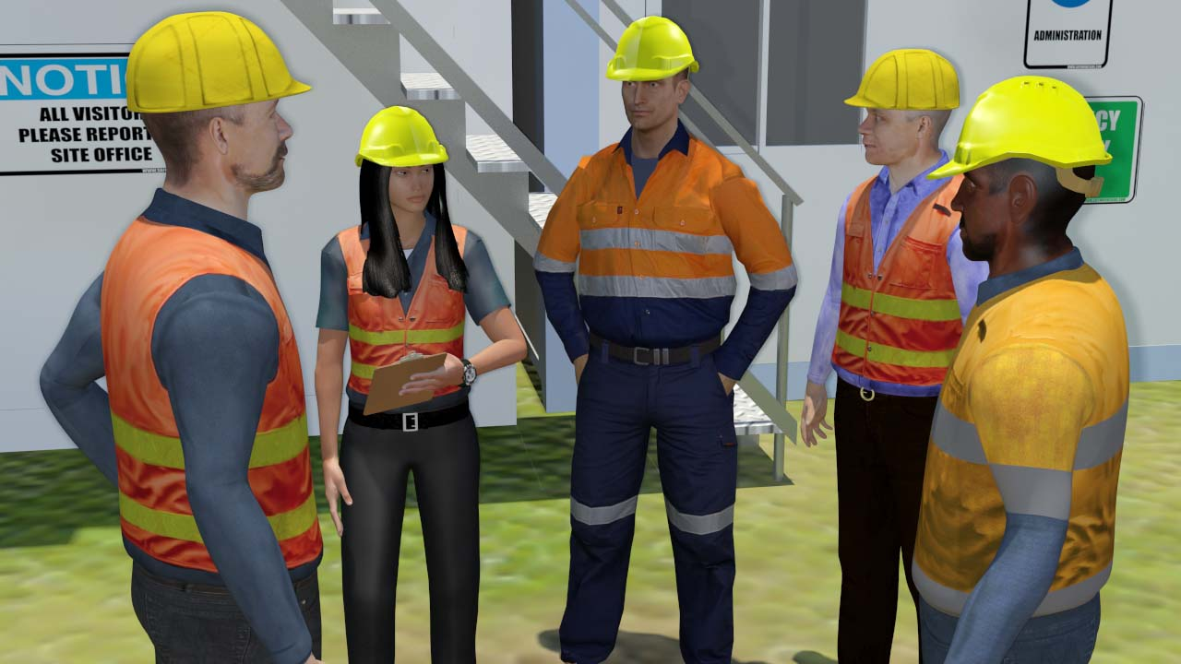
Participate in Discussions
Team meetings.
Toolbox talks.
Health and safety discussions.
Project planning meetings.
Near miss or incident discussions.
Notes:
38
You may need to take part in discussions with personnel to receive and clarify information about the task. Discussions include:
Team meetings.
Toolbox talks.
Health and safety discussions.
Project planning meetings.
Near miss or incident discussions.

Slide 39
Communicate Cooperatively
Deal with other people honestly, professionally and with respect.
Be aware of cultural differences between workers and choose your words and approach carefully.
If you are having difficulty talking or communicating with some personnel you should speak with your supervisor and discuss different ways you can communicate effectively.
Notes:
39
Any face-to-face communication should follow basic communication etiquette. Deal with other people honestly, professionally and with respect. For example it is counter-productive to shout or insult others, give them incorrect information, or not listen to other people’s ideas when talking to them.
Be aware of cultural differences between workers and choose your words and approach carefully. Other people may have different values, beliefs, attitudes and experiences to your own. The words you use may be offensive to some people.
If you are having difficulty talking or communicating with some personnel you should speak with your supervisor and discuss different ways you can communicate effectively.

Slide 40
Communication Practical
Notes:
40
Tagging an item involves placing a tag on the piece of equipment so that others are aware that it should not be used. This is also known as ‘isolation’.
This tag will need to stay in place until the fault has been fixed and the equipment has been certified as fit for use. Never use an item of communication that has been tagged out and never remove the tags from the equipment.

Slide 41
Activity Trial

Slide 42
Activity One
T
05070901

Slide 43
Activity Two
aDeT

Slide 44
Activity Three
D
2GYgU34mnETpHZ

Slide 45
Activity Four
z
46523987

Slide 46
Activity Five
M hoW r U gOiNg ?

Slide 47
Activity Six
486
123
A
b
C
d

Slide 48
Activity Seven

Slide 49
Activity Eight

Slide 50
Activity Nine

Slide 51
Activity Ten

Slide 52
Activity Eleven

Slide 53
Activity Twelve

Slide 54
Verbal Communication

Slide 55
Activity
Select a topic that you are passionate about
You will be required to speak on this topic for two minutes in a one on one situation
Whatever happens you must complete your two minute presentation
WHS Warning !
No hitting, spitting, kicking, throwing things, name calling or eye gouging.

Slide 56
Complete Documentation

Slide 57
Complete Required Documentation
As a part of your job you may need to complete paper or computer generated documentation.
There may be strict timeframes set for completion or submission. Make sure you meet these, or warn the people expecting them if there is going to be a delay.
Use clear and simple language when filling in forms and make sure your handwriting is neat.
Notes:
57
As part of your job requirements, you may need to complete paper or computer generated documentation. All required documents should be filled out properly and on time.
There may be strict timeframes set for completion or submission. Make sure you meet these, or warn the people expecting them if there is going to be a delay.
Use clear and simple language when filling in forms and make sure your handwriting is neat enough to read. This will help to make sure that other people can understand it properly. If you have trouble writing you can ask somebody to help you complete the documents.

Slide 58
Complete Required Documentation
Thoroughly check all information that is entered into written documents.
Once written documents are completed, they should be processed and filed in accordance with your event protocols and procedures.
Notes:
58
Thoroughly check all information that is entered into written documents. Inaccurate, missing or misleading information can cause confusion, delays, hazards or legal issues.
Once written documents are completed, they should be processed and filed in accordance with your site’s protocols and procedures. In some cases you may need to keep a copy of written documentation for yourself.

Slide 59
Pass on Written Information
Some documents may need to be reviewed and signed off by appropriate personnel.
Make sure that any documents that need to be passed on are delivered promptly.
Follow all standard procedures and make sure all of the information required is handed over without delay.
Notes:
59
Documents, especially computer generated ones, are passed between personnel on a regular basis in most places of work.
Some documents may need to be reviewed and signed off by appropriate personnel. You may be authorised to sign some documents yourself. Pass on any documents you have completed for processing and filing.
Make sure that any documents that need to be passed on to other personnel, departments or external agencies are delivered promptly. You must make sure that the written documentation has been completed fully and following your site’s procedures, and is being sent to the appropriate individual or department.
Written documentation around incidents may need to be passed on to a range of external authorities. Follow all standard procedures and make sure all of the information required is handed over without delay.

Slide 60
Event Traffic Controllers
Core Aspects
All cycle events must be planned - WHS requirement and the plan documented. This plan should include a “communication plan” for both normal and emergency situations.
Prior to the cycle event occurring, even traffic controllers should be briefed about what is likely to occur during the event. Contacts for Event Manager/Race Director
Notes:
60
As part of your job requirements, you may need to complete paper or computer generated documentation. All required documents should be filled out properly and on time.
There may be strict timeframes set for completion or submission. Make sure you meet these, or warn the people expecting them if there is going to be a delay.
Use clear and simple language when filling in forms and make sure your handwriting is neat enough to read. This will help to make sure that other people can understand it properly. If you have trouble writing you can ask somebody to help you complete the documents.

Slide 61
Event Traffic Controllers
Core Aspects
Event traffic controllers are the visible face of any cycle event and should behave accordingly. All communication needs to be courteous, clear and concise and unambiguous.
During and after the cycle event, event traffic controllers need to complete essential documentation which is likely to include: completion of the WHS / TGS day sheet, completion of the incident log.
Notes:
61
As part of your job requirements, you may need to complete paper or computer generated documentation. All required documents should be filled out properly and on time.
There may be strict timeframes set for completion or submission. Make sure you meet these, or warn the people expecting them if there is going to be a delay.
Use clear and simple language when filling in forms and make sure your handwriting is neat enough to read. This will help to make sure that other people can understand it properly. If you have trouble writing you can ask somebody to help you complete the documents.

Slide 62
Activity
Notes:
62

